Slide 1

MINOR PROJECT PRESENTATION

Slide 2
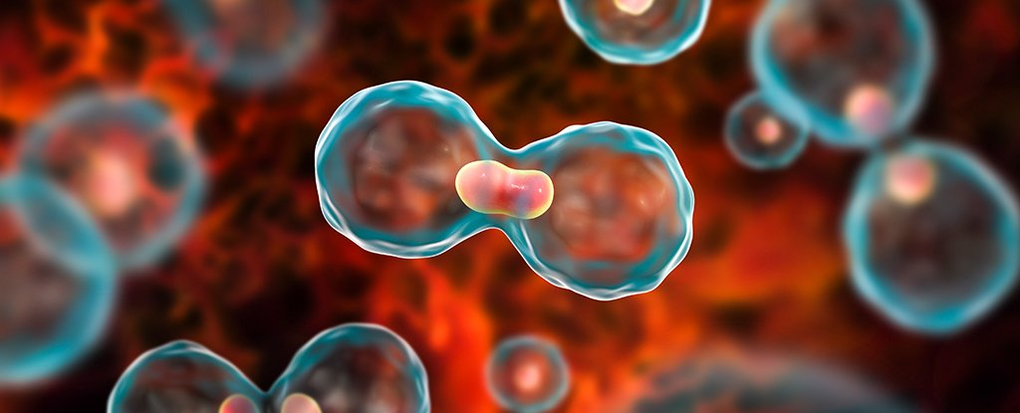
CANCER DETECTION USING MACHINE LEARNING

Slide 3
Dr. AKHILESH PANCHAL
[Department of Electronics and Communication Engineering]
SUPERVISOR
Dr. DEEPA SHARMA
[Department of Electronics and Communication Engineering]
CO-ORDINATOR

Slide 4

TEAM MEMBERS
YELURI BHARATH RAJ
PULI PRADEEP
AMGOTHU JAYARAM NAIK
BANALA ABHISHEK SATWIK

Slide 5


Slide 6
TABLE
OF
CONTENTS
INTRODUCTION
Introduction to Cancer Detection Using Machine Learning by Naive Bayes
FLOW CHART
Advantages of Using Naive Bayes for Cancer Detection
Challenges in Using Naive Bayes for Cancer Detection
Applications of Naive Bayes in Cancer Detection
Future Scope of Cancer Detection Using Machine Learning by Naive Bayes
Conclusion

Slide 7
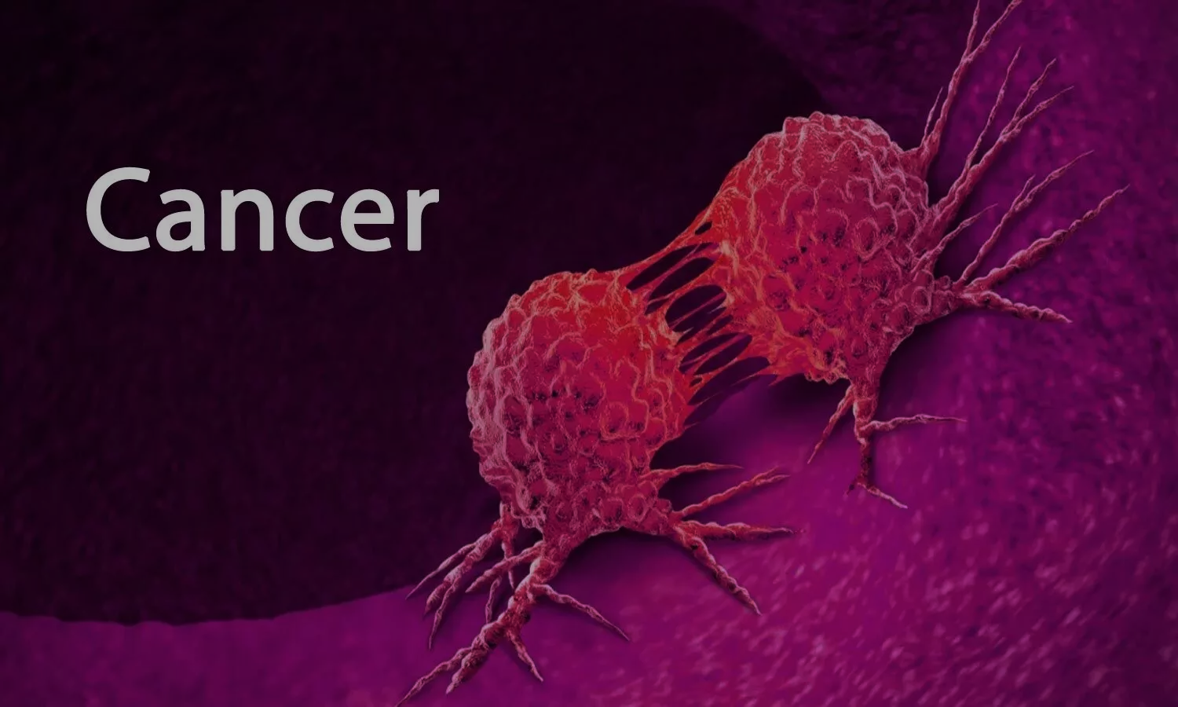
According to the Centers for Disease Control and Prevention (CDC)Trusted Source, breast cancer is the most common cancer in women. Breast cancer survival rates vary widely supported by many factors.
Two of the most important factors are the type of cancer women have and the stage of cancer at the time they receive a diagnosis. Breast cancer is cancer that develops in breast cells.
Typically, the cancer forms in either the lobules or the ducts of the breast. Cancer also can occur within the adipose tissue or the fibrous connective tissue within your breast. The uncontrolled cancer cells often invade other healthy breast tissue and may visit the lymph nodes under the arms.
INTRODUCTION

Slide 8
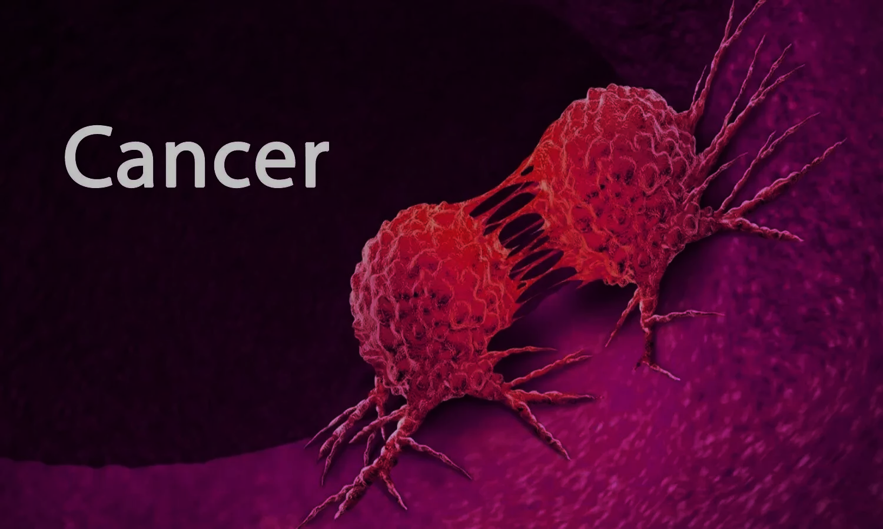
Doctors say that breast cancer happened due to abnormal growth of cells in the breast and these cells spread in size like Meta Size from breast to lymph nodes or the other parts of the body also.
Hence it is necessary to detect and stop the growth of these unwanted cells as early as possible to avoid the next phase consequences.
If a tumor is diagnosed then the first step taken by the doctor is, they check whether the tumor is Benign or Malignant. Because the treatment and prevention methods of both the tumors are different.
Benign cells are neither cancerous and nor spread but Malignant cells are cancerous and can spread to other parts of bodies.
The problem with this disease is, there is no such proper diagnostic machine is present to detect cancer in the early phase so the person can start the treatment as early as possible and try to stop the growth of unwanted cells or tumors.

Slide 9

Introduction to Cancer Detection Using Machine Learning by Naive Bayes
Cancer is one of the leading causes of death worldwide. Early detection of cancer can significantly increase the chances of successful treatment and survival. Machine learning algorithms have shown great potential in detecting cancer at an early stage. Naive Bayes is a popular machine learning algorithm that has been used for cancer detection.
Naive Bayes is a probabilistic algorithm that uses Bayes' theorem to calculate the probability of a given event based on prior knowledge. In the context of cancer detection, Naive Bayes can be used to predict the likelihood of a patient having cancer based on various factors such as age, gender, family history, and other medical conditions.

Slide 10
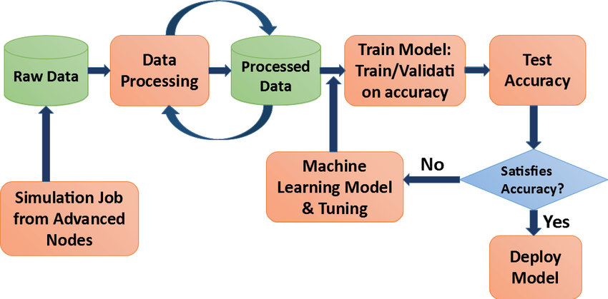
FLOW CHART

Slide 11
Advantages of Using Naive Bayes for Cancer Detection
One of the main advantages of using Naive Bayes for cancer detection is its simplicity. Naive Bayes is easy to understand and implement, making it an ideal choice for healthcare professionals who may not have a background in machine learning.
Another advantage of using Naive Bayes is its ability to handle large datasets. Cancer detection requires analyzing a large amount of data, and Naive Bayes can process this data quickly and accurately. Additionally, Naive Bayes can handle missing data, which is common in medical datasets.

Slide 12
Challenges in Using Naive Bayes for Cancer Detection
While Naive Bayes has many advantages, there are also challenges in using it for cancer detection. One challenge is the assumption of independence between variables. This assumption may not hold true in real-world scenarios, as variables such as age and family history may be correlated.
Another challenge is the need for high-quality data. Naive Bayes relies on accurate and complete data to make predictions. If the data is incomplete or inaccurate, the results may be unreliable. Additionally, Naive Bayes may not be suitable for detecting rare types of cancer, as the algorithm may not have enough data to make accurate predictions.

Slide 13
PRECISION:- Precision is one indicator of a machine learning model's performance – the quality of a positive prediction made by the model. Precision refers to the number of true positives divided by the total number of positive predictions (i.e., the number of true positives plus the number of false positives).
RECALL:- Recall, also known as the true positive rate (TPR), is the percentage of data samples that a machine learning model correctly identifies as belonging to a class of interest—the “positive class”—out of the total samples for that class.
F1 SCORE:- F1 score is a machine learning evaluation metric that measures a model's accuracy. It combines the precision and recall scores of a model. The accuracy metric computes how many times a model made a correct prediction across the entire dataset.
MACRO AVG:- The macro average is the arithmetic mean of the individual class related to precision, memory, and f1 score. We use macro average scores when we need to treat all classes equally to evaluate the overall performance of the classifier against the most common class labels.
WEIGHTED AVG:- Weighted average or weighted sum ensemble is an ensemble machine learning approach that combines the predictions from multiple models, where the contribution of each model is weighted proportionally to its capability or skill. The weighted average ensemble is related to the voting ensemble.

Slide 14
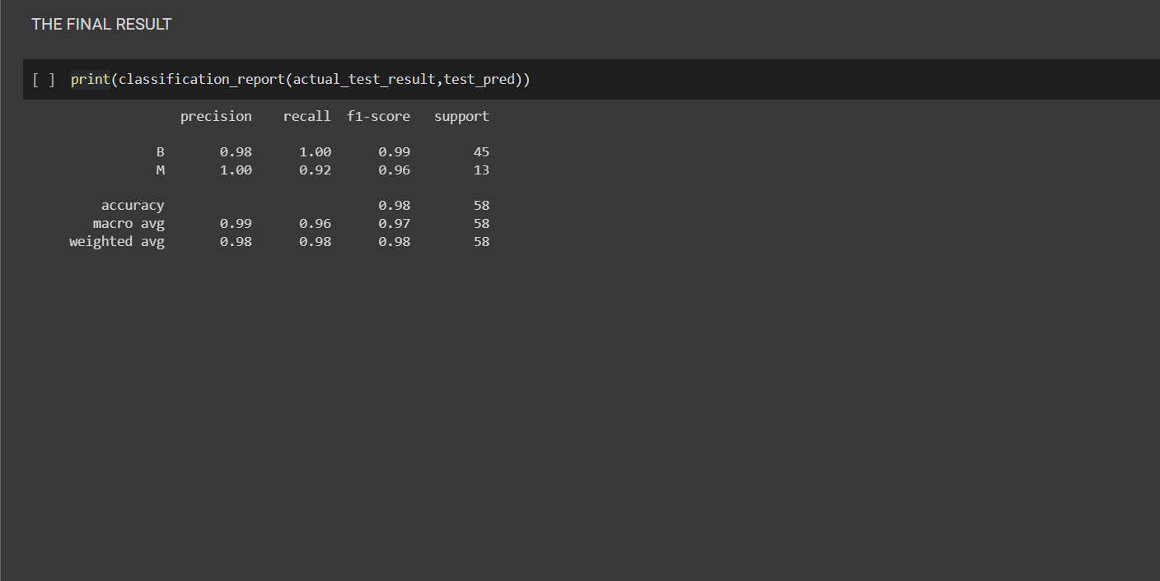

Slide 15
Applications of Naive Bayes in Cancer Detection
Naive Bayes has been used in various applications for cancer detection. One application is in breast cancer detection, where Naive Bayes has been used to analyze mammography images and predict the likelihood of cancer.
Another application is in lung cancer detection, where Naive Bayes has been used to analyze CT scans and predict the likelihood of cancer. Naive Bayes has also been used in prostate cancer detection, skin cancer detection, and other types of cancer detection.

Slide 16
Future Scope of Cancer Detection Using Machine Learning by Naive Bayes
The future of cancer detection using machine learning by Naive Bayes looks promising. As more data becomes available, Naive Bayes can be trained to make even more accurate predictions. Additionally, new techniques such as deep learning can be combined with Naive Bayes to improve cancer detection.
Furthermore, the use of mobile devices and wearable technology can provide real-time data for cancer detection. Naive Bayes can be integrated into these devices to provide instant feedback and alerts for potential cancer cases. With continued research and development, Naive Bayes has the potential to revolutionize cancer detection and save countless lives.

Slide 17
Conclusion
In conclusion, cancer detection using machine learning by Naive Bayes is a promising area of research. Naive Bayes has many advantages, such as simplicity and the ability to handle small datasets, but also has challenges such as the assumption of independence between variables and the need for high-quality data.
Despite these challenges, Naive Bayes has been successfully applied in various applications for cancer detection, and its future looks bright with the potential for even more accurate predictions through the use of deep learning and real-time data from mobile devices and wearable's.

Slide 18


